Slide 1


Relational Abstract Interpretation for Enforcing Information Flow Security
Seyed Mohammad Mehdi Ahmadpanah
smahmadpanah@aut.ac.ir
Supervisor
Dr. Mehran S. Fallah
Formal Security Lab.
CEIT@AUT
Jul. 31, 2018

Slide 2

Outline
An Introduction to Abstract Interpretation
Abstract Domain
Abstract Transform
Galois Connection
Combination of Galois Connections
Relational Abstract Interpretation for Verification of 2-hypersafety properties
Via self-composition of CFG
XML manipulating language

Slide 3

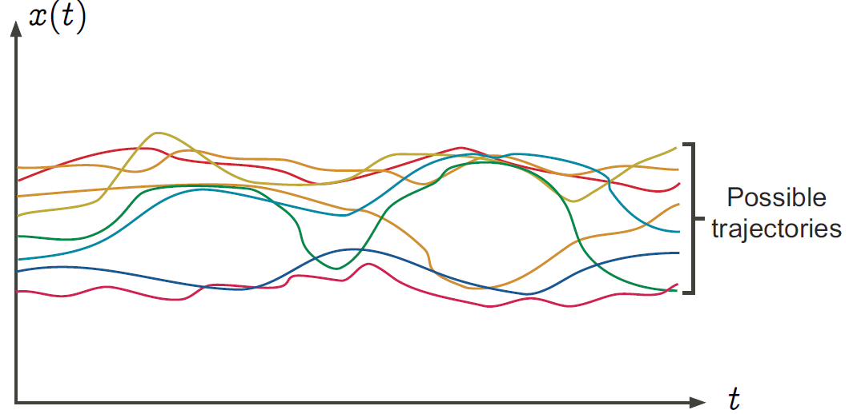
Introduction
Concrete Semantics
formalizes the set of all possible executions of this program in all possible execution environments (Possible Behaviors)

Slide 4
Introduction
Undecidability
The concrete mathematical semantics of a program is an “infinite” mathematical object, not computable;
All non trivial questions on the concrete program semantics are undecidable (e.g. termination).
Assume termination(P) would always terminates and returns true iff P always terminates on all input data
P ≡ while termination(P) do skip od

Slide 5
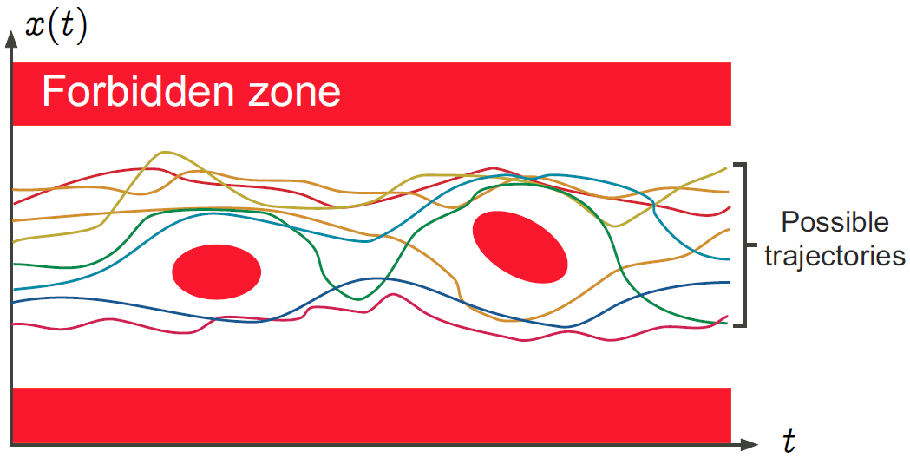
Introduction
Safety Property
expresses that no possible execution of the program when considering all possible execution environments can reach an erroneous state
Notes:
The verification of safety properties consists in proving that the intersection of the concrete semantics of the program with the forbidden zone is empty. Since the program concrete semantics is not computable, the verification problem is undecidable. It is not always possible to answer the safety questions completely automatically, with finite computer resources, without any uncertainty about the answer and without any human intervention.

Slide 6
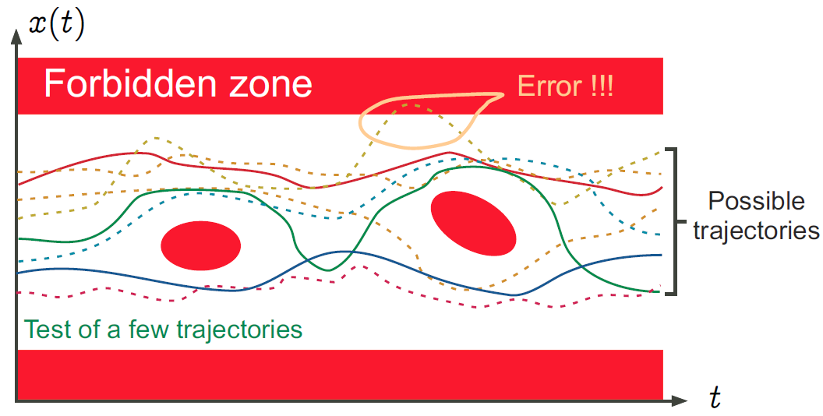
Introduction
Property Testing/Debugging
consists in considering a subset of the possible executions and not a correctness proof;
absence of coverage is the main problem

Slide 7
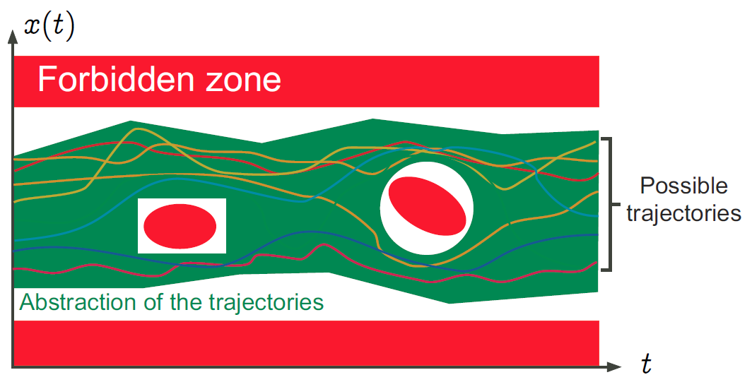
Introduction
Abstract Interpretation
consists in considering an abstract semantics, that is to say a superset of the concrete semantics of the program
the abstract semantics covers all possible concrete cases
correct: if the abstract semantics is safe (does not intersect the forbidden zone) then so is the concrete semantics
Notes:
Abstract Interpretation is the study of language semantics and analyses of varying abstraction levels

Slide 8
Introduction
Formal Methods are Abstract Interpretations!
Model Checking: abstract semantics is given manually by the user (a finitary model of the program execution)
Deductive Methods: the user must provide the abstract semantics in the form of inductive arguments
Static Analysis: the abstract semantics is computed automatically from the program text according to predefined abstractions
Notes:
Formal methods are abstract interpretations, which differ in the way to obtain the abstract semantics:

Slide 9
Introduction
Requirements of Abstract Semantics
sound so that no possible error can be forgotten
no conclusion derived from the abstract semantics is wrong relative to the program concrete semantics and specification
precise enough (to avoid false alarms)
as simple/abstract as possible

Slide 10
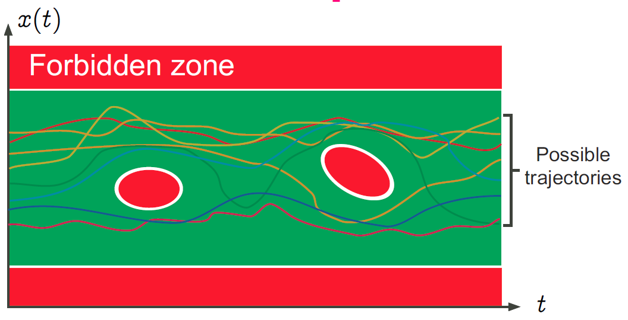
Introduction
Correct and precise semantics

Slide 11
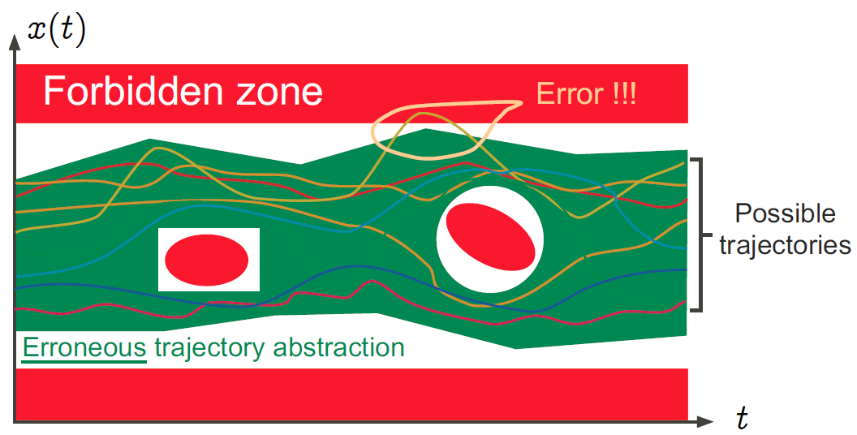
Introduction
Erroneous semantics

Slide 12
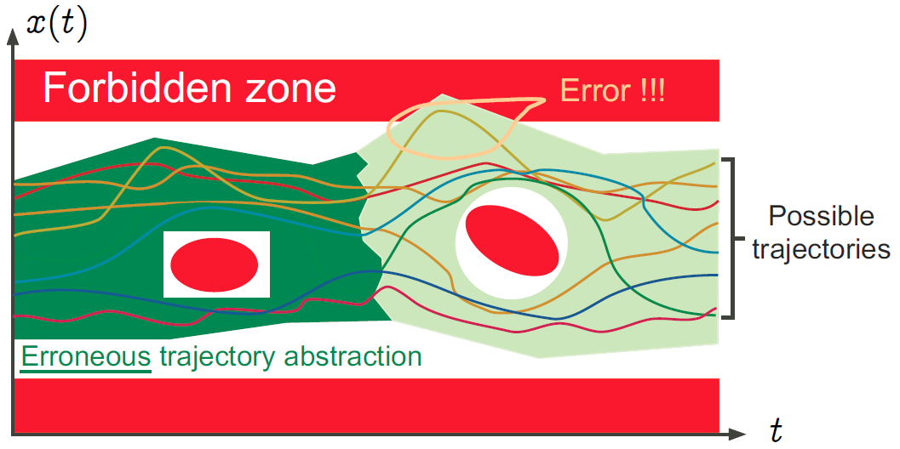
Introduction
Another erroneous semantics (bounded model checking)

Slide 13
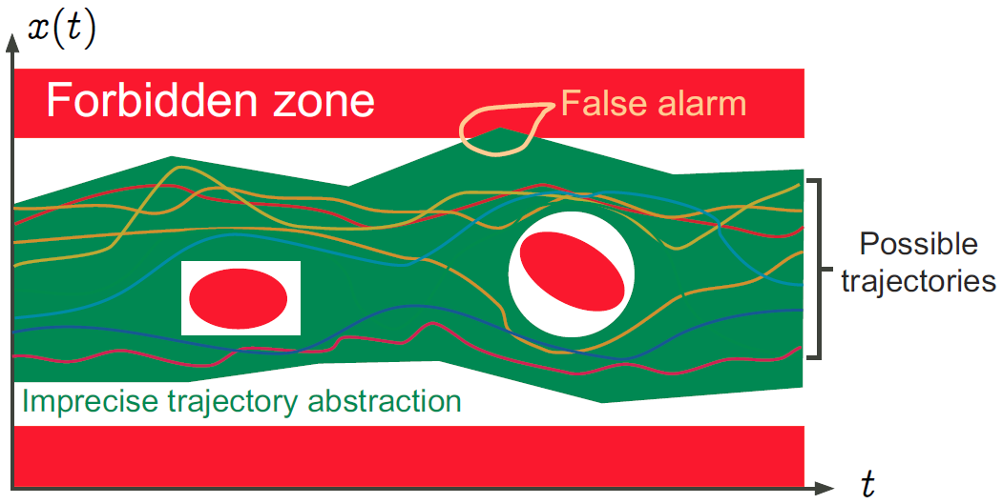
Introduction
Imprecise semantics (False Alarms)

Slide 14
Abstract Domain and Transform
Abstract Domain
providing a description of abstract program properties and abstract property transformers describing the operational effect of program instructions and commands in the abstract.
Standard abstractions
that serve as a basis for the design of static analyzers
abstract program data
abstract program basic operations
abstract program control (iteration, procedure, concurrency,…)
can be parametrized to allow for manual adaptation to the application domains

Slide 15
Abstract Domain and Transform
Most program properties can be expressed as fixpoints of monotone or extensive property transformers, a property preserved by abstraction.
This reduces program analysis to fixpoint approximation and verification to fixpoint checking.

Slide 16
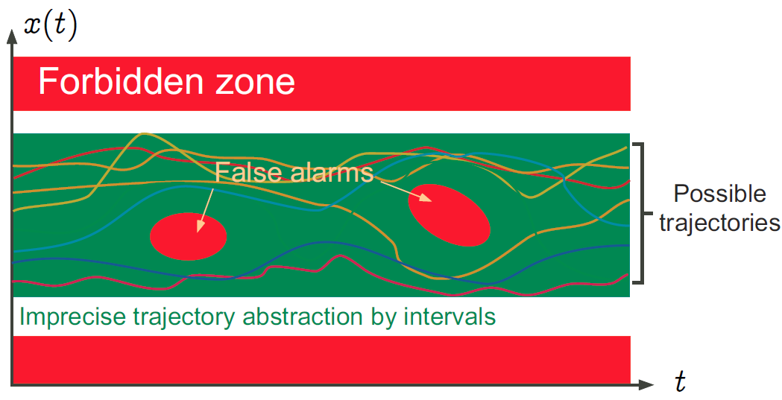
Abstract Domain and Transform
Standard abstraction by intervals

Slide 17
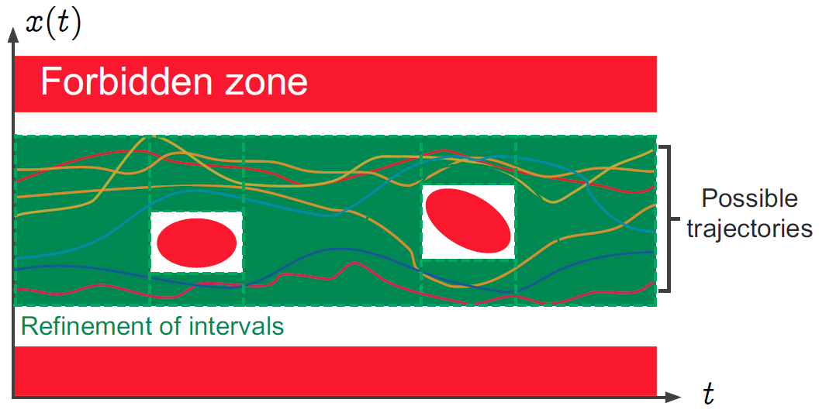
Abstract Domain and Transform
More refined abstraction

Slide 18
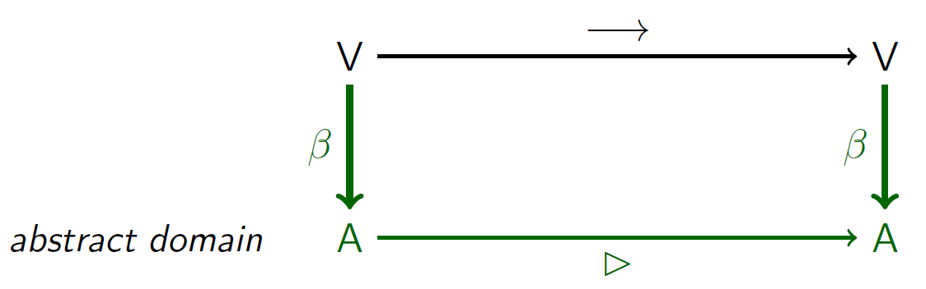
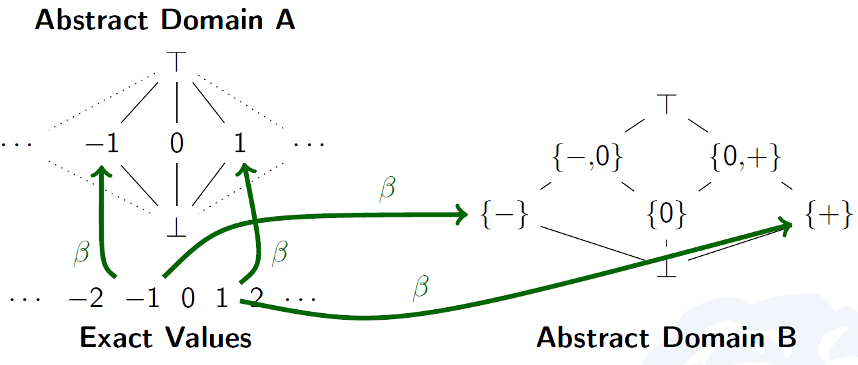
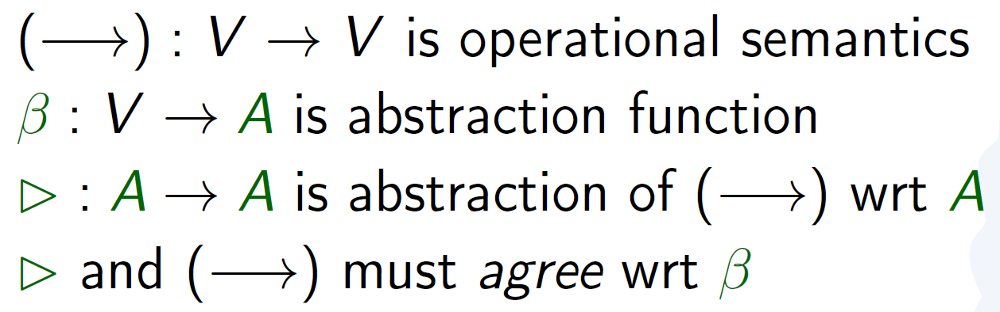
Abstract Domain and Transform
Approximation Options (Abstract Domains)
x := y * z
Notes:
Bot: don’t know yet
Top: anything
Beta: representation function (into abstract domain)

Slide 19
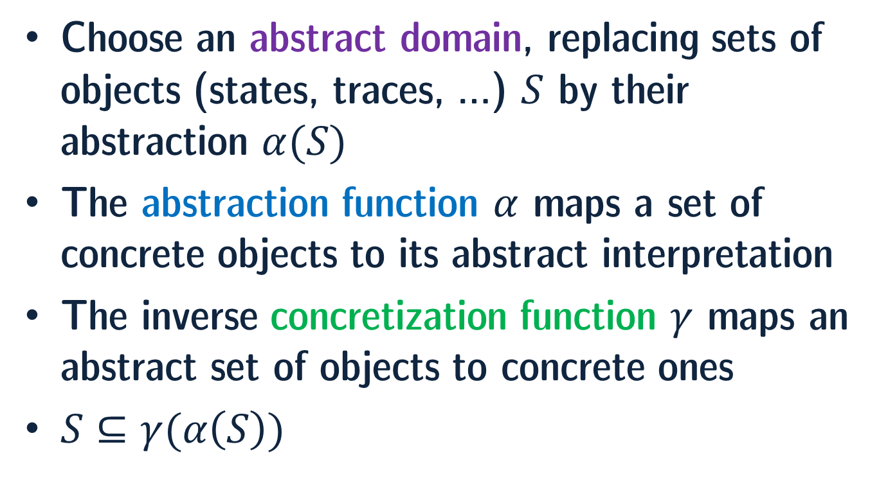
Abstract Domain and Transform
Choose an abstract domain, replacing sets of objects (states, traces, …) $S$ by their abstraction $α(S)$
The abstraction function $α$ maps a set of concrete objects to its abstract interpretation
The inverse concretization function $γ$ maps an abstract set of objects to concrete ones
$S⊆γ(α\left(S\right))$

Slide 20
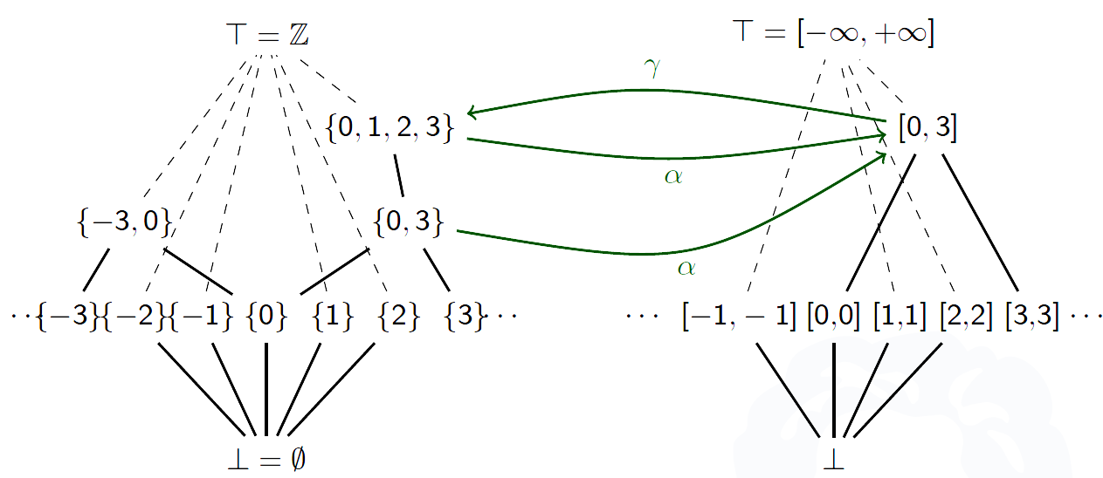
Abstract Domain and Transform

Slide 21
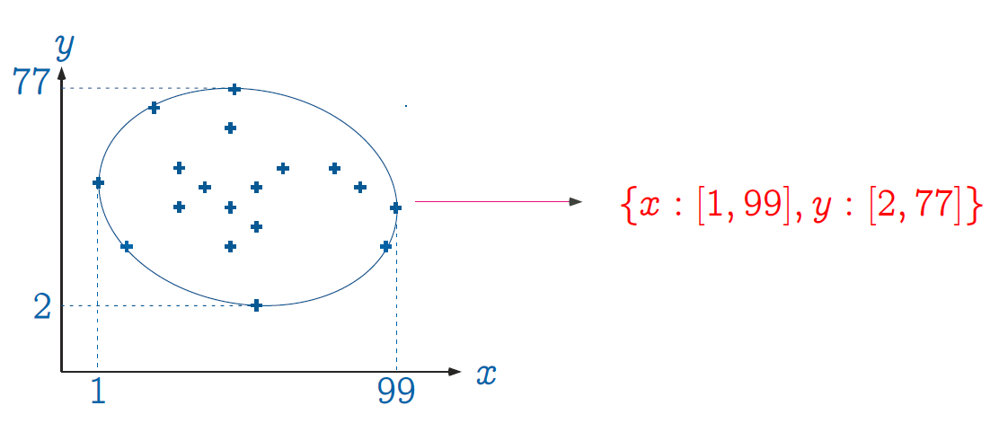
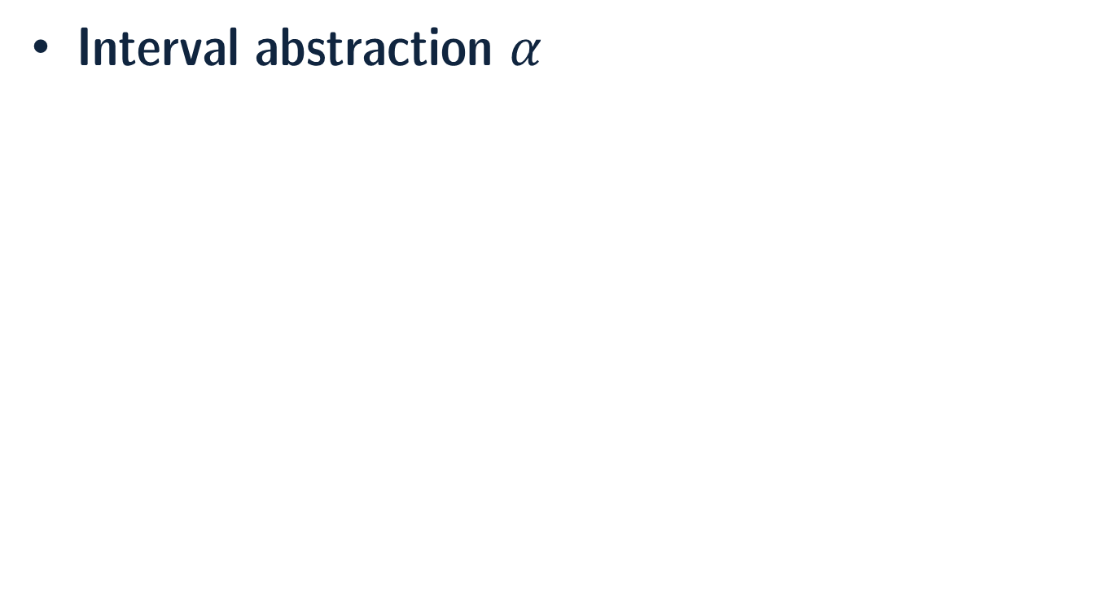
Abstract Domain and Transform
Interval abstraction $α$

Slide 22
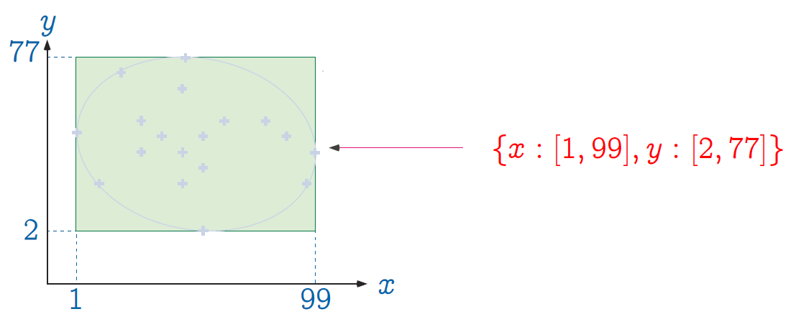
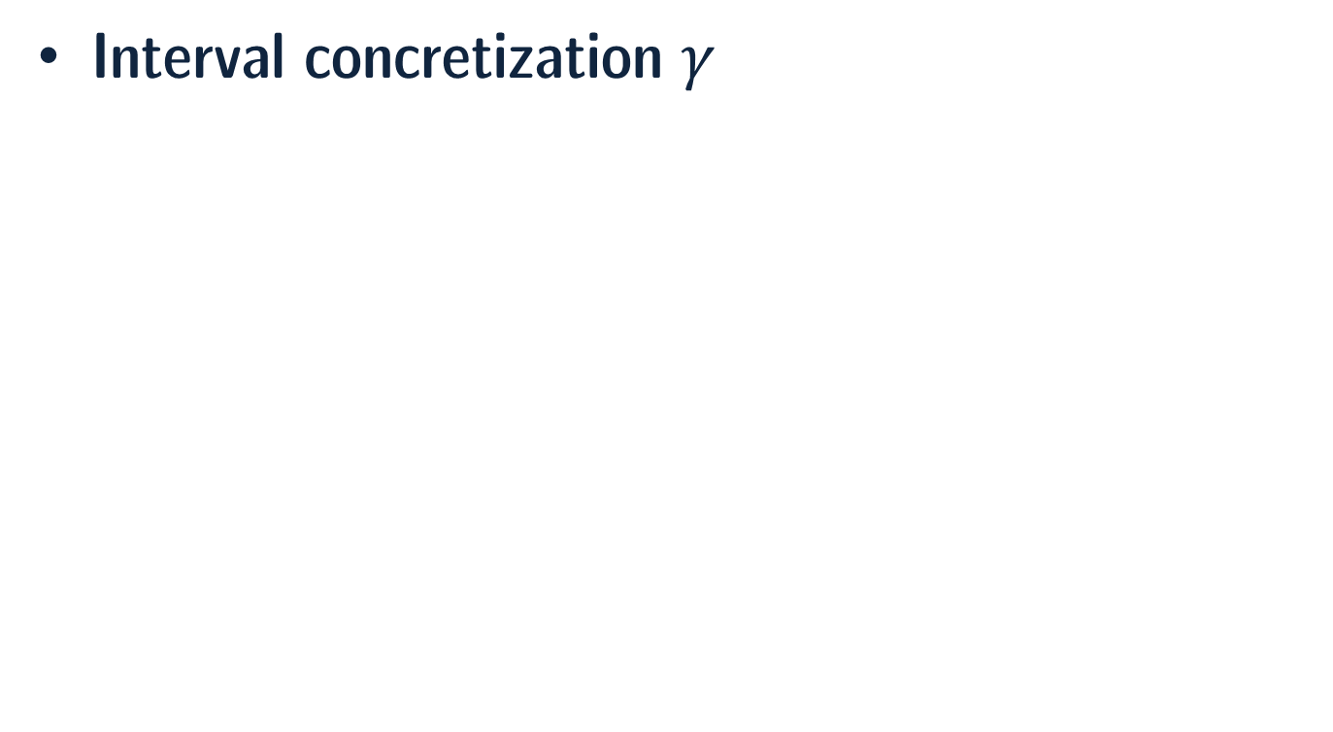
Abstract Domain and Transform
Interval concretization $γ$

Slide 23
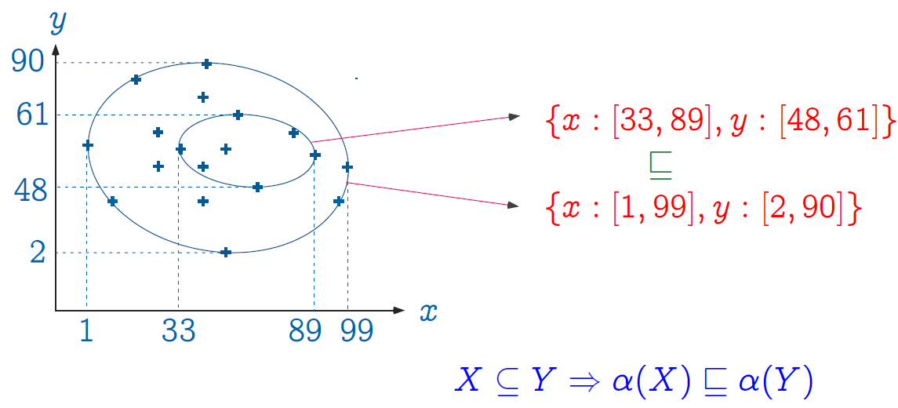
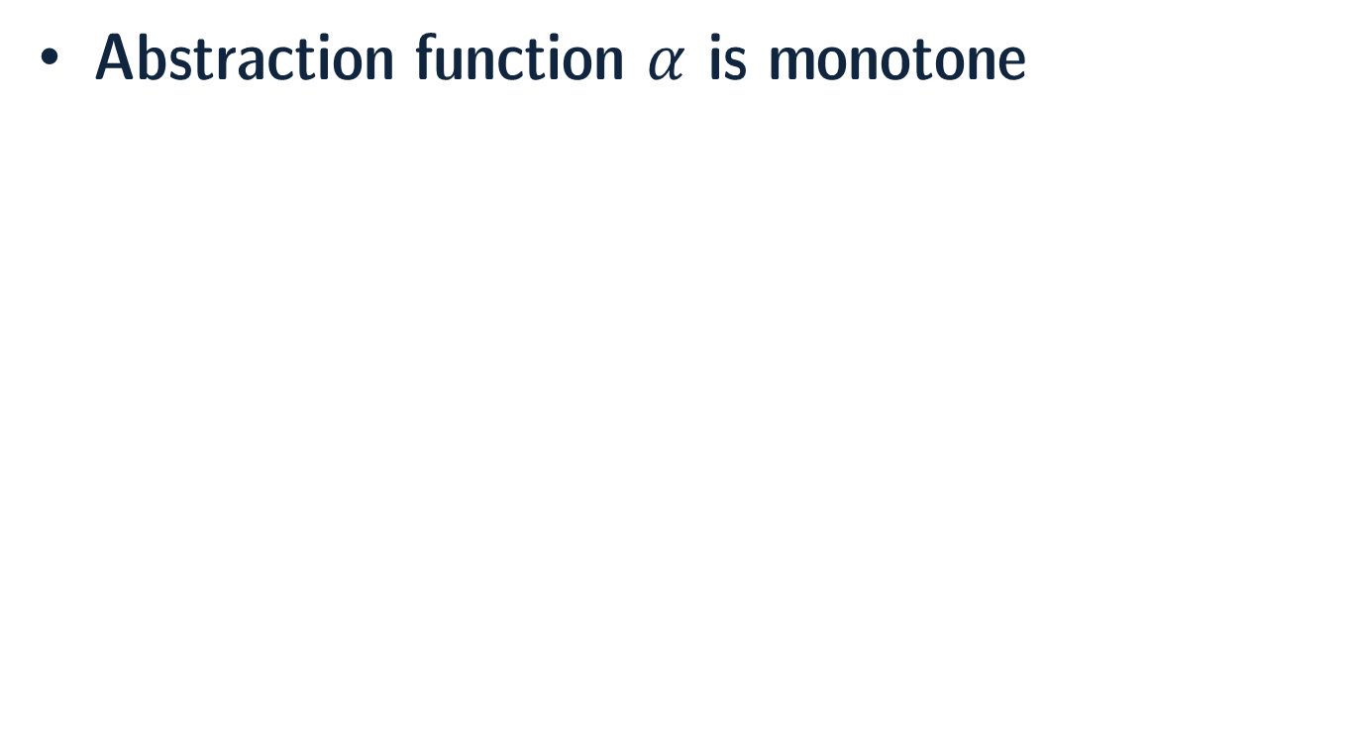
Abstract Domain and Transform
Abstraction function $α$ is monotone

Slide 24
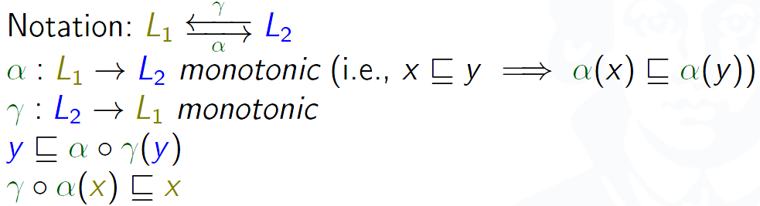
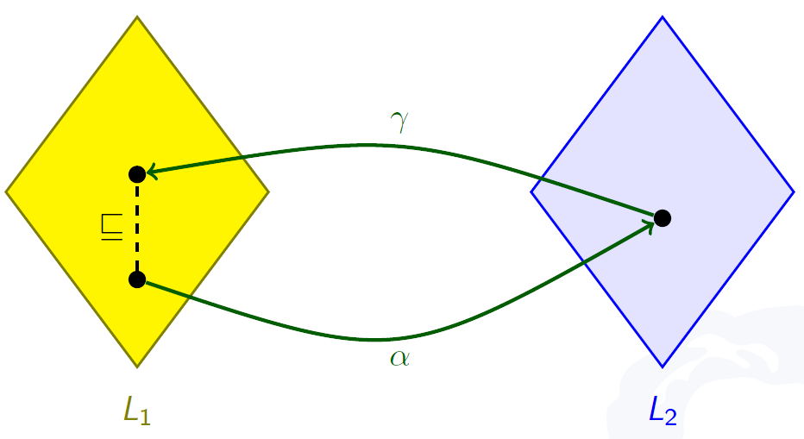
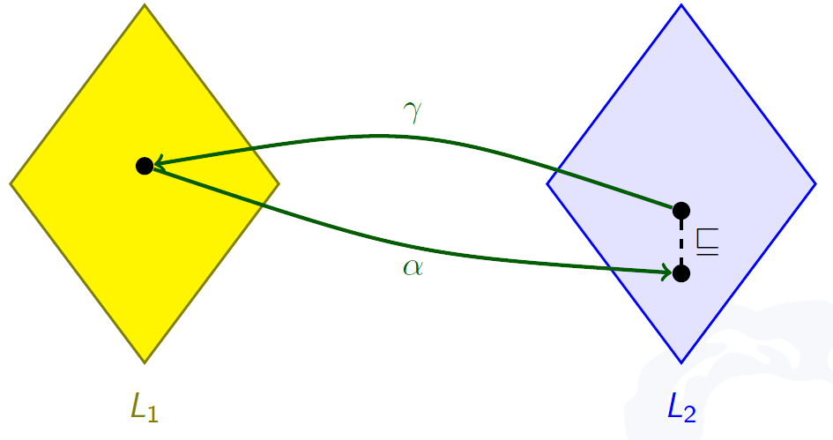
Galois Connection

Slide 25
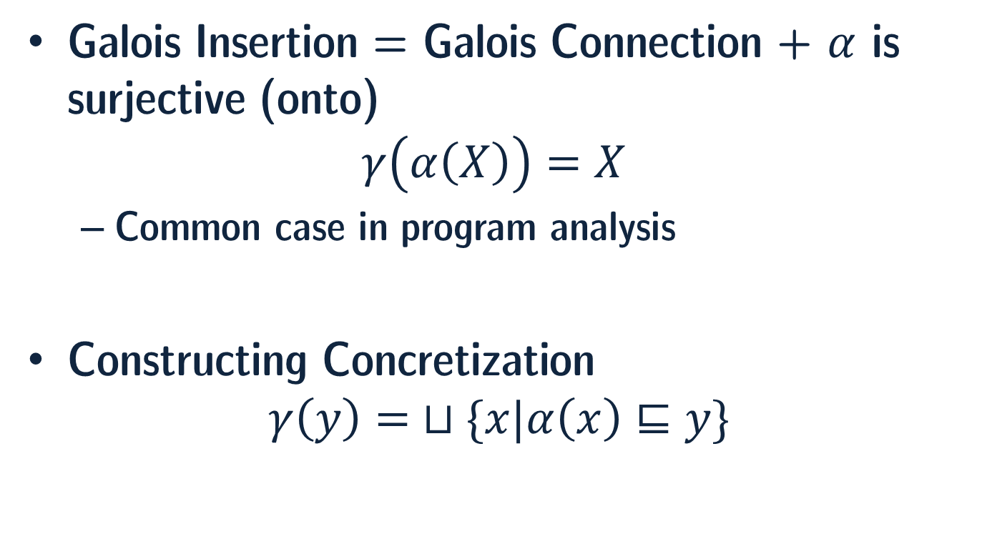
Galois Connection
Galois Insertion = Galois Connection + $α$ is surjective (onto)
$$γ\left(α\left(X\right)\right)=X$$
Common case in program analysis
Constructing Concretization
$$γ\left(y\right)= ⊔\{x|α\left(x\right)⊑y\}$$

Slide 26
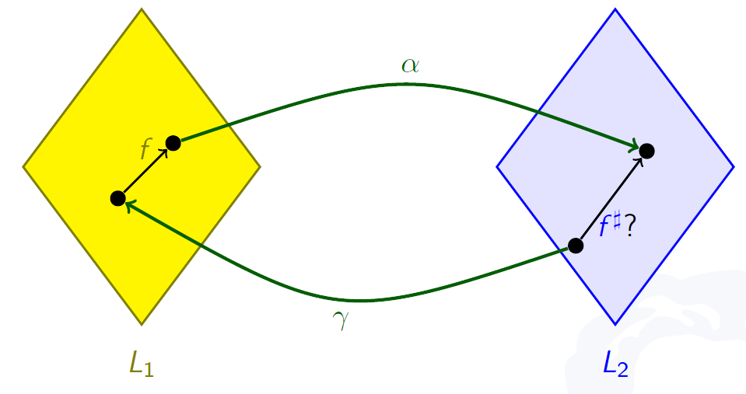
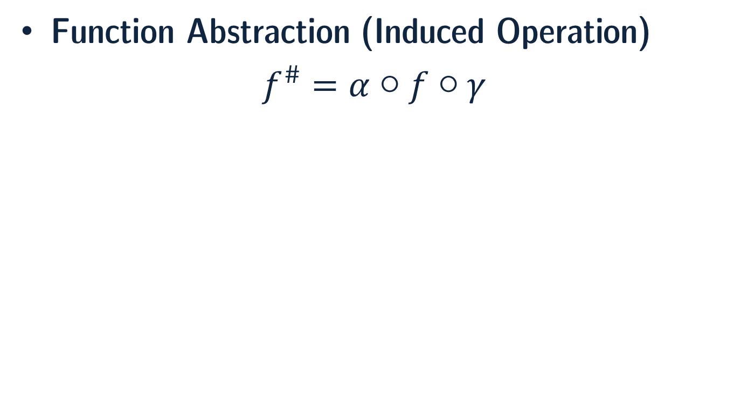
Galois Connection
Function Abstraction (Induced Operation)
$f^{\#}=α○f○γ$

Slide 27
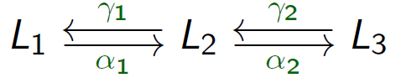
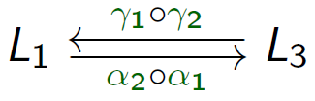
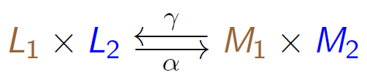
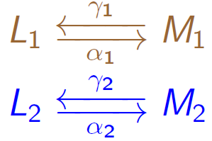
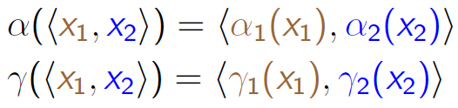
Combination of Galois Connections
Sequence
Product (Independent Attributes)

Slide 28
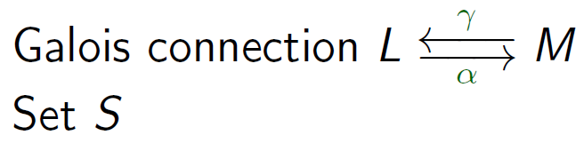
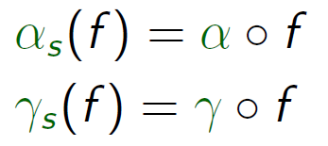
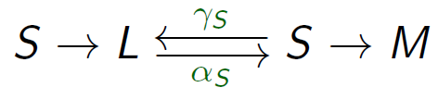
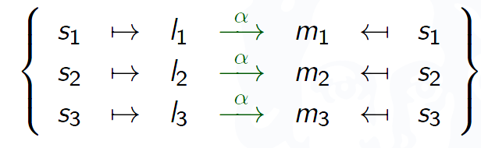
Combination of Galois Connections
Function

Slide 29
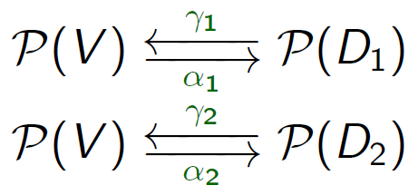
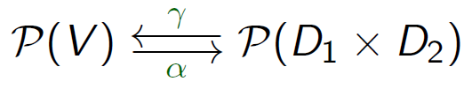
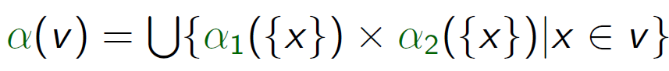
Combination of Galois Connections
Tensor Product

Slide 30
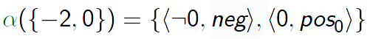
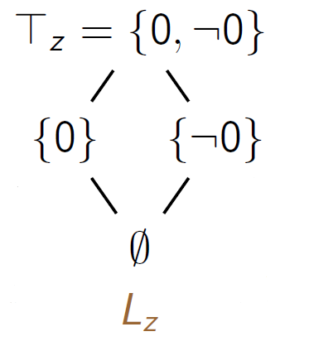
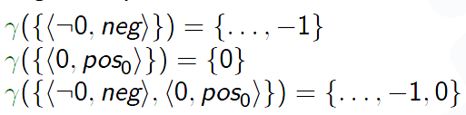
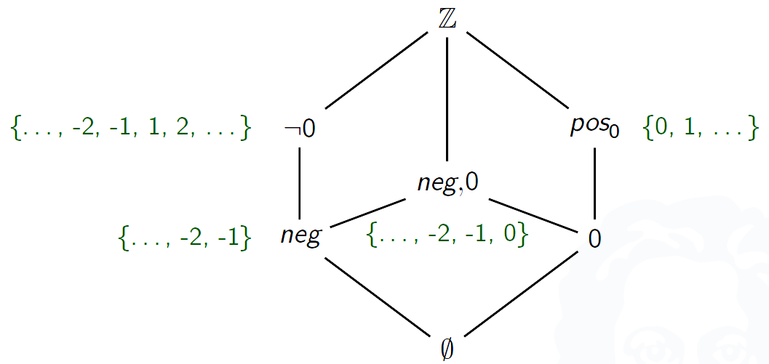
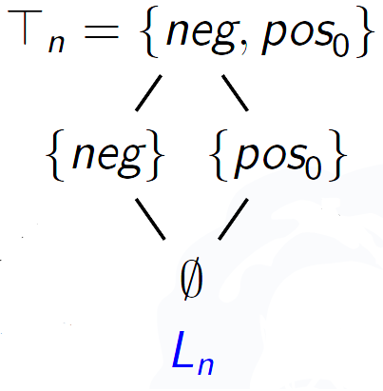
Combination of Galois Connections
Tensor Product
Notes:
Improving precision

Slide 31
Abstract-interpretation-based tools
Sound but incomplete tools that vary in their capacity to produce very few false alarms and to scale up to very large programs:
Airac5 : static analyzer for automatic detection of buffer overrun errors in C programs.
aiT WCET Analyzers: Commercial static analyzers to statically compute tight bounds for the worst-case execution time (WCET) of tasks in real-time systems.
ASTRÉE: A static analyzer for proving the absence of runtime errors specialized for synchronous control/command programs written in C.
C Global Surveyor: A research prototype static analyzer for finding runtime errors in C programs.
Fluctuat: A static analyzer to study the propagation of rounding errors in floating-point computations of C or assembler programs.
PolySpace Verifier: A commercial general-purpose static analyzer for detecting runtime errors in Ada, C, C++, and Java.
TERMINATOR: A static analyzer for proving program termination and general liveness properties of C programs.
TVLA: a research tool for experimenting with abstract interpretation using a logical description of program semantics with a predefined abstraction of predicates.

Slide 32
Relational Abstract Interpretation for the Verification of 2-Hypersafety Properties

Slide 33
Motivation
Abstract interpretation is a well established approach for proving safety properties of programs
Information Flow policies are formalized as safety hyperproperties
Properties of multiple runs
The verification of k-hypersafety properties can be reduced to the verification of ordinary safety properties of the k-fold self-composition of the program

Slide 34
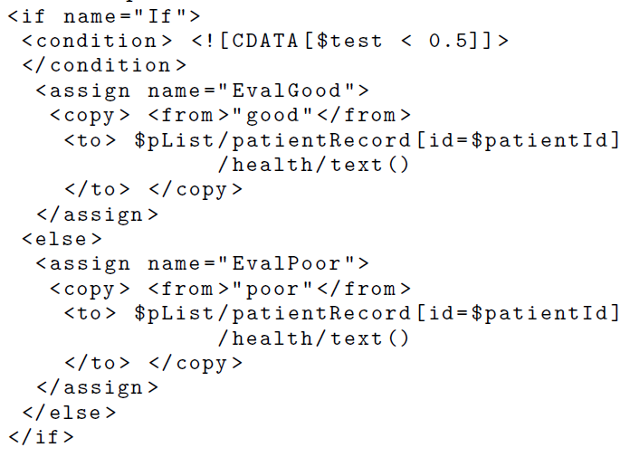
Motivation
A method for proving 2-hypersafety properties
Using self-composition on control flow graphs (CFG)
Noninterference
two executions are indistinguishable based on public observations if their initial states only differ in secret data
Target: programs written in an XML manipulating language
Web Services Business Process Execution Language (BPEL)
Notes:
A method to prove properties like this automatically using static analysis

Slide 35
Set up
Execution = sequence of assignments and condition evaluations
Inserting skip instructions into arbitrary places of an execution does not change the result
Different alignments of a pair of executions
Knowing an initial abstract value (the potential set of pairs of initial states), computing the final abstract value (the possible set of pairs of states that can result from any pairs of executions)

Slide 36
Main Idea
Relational abstract domain describing pairs of concrete states + abstract transformers for pairs of instructions set in alignment within the two executions
The abstract effect of a given pair of executions w.r.t a fixed alignments of instructions
By applying the composition of the occurring transformers to the initial abstract value
Abstract effect of any alignment results in a safe overapproximation of the desired outcome
Approximate it with the glb over all alignments

Slide 37
Main Idea
To obtain a safe approximation for all pairs of executions reaching a given pair of program points
lub of the values provided for each pair of executions individually
Merge over all Twin Computations (MTC) solution
To achieve maximal precision, the structural similarities of two subprograms are taken into account using a tree distance measure during the construction.
Selecting one promising static alignment of instructions for each pair of executions resulting in a self-composition of the CFG of the program.

Slide 38
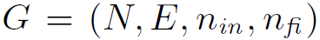
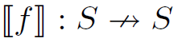
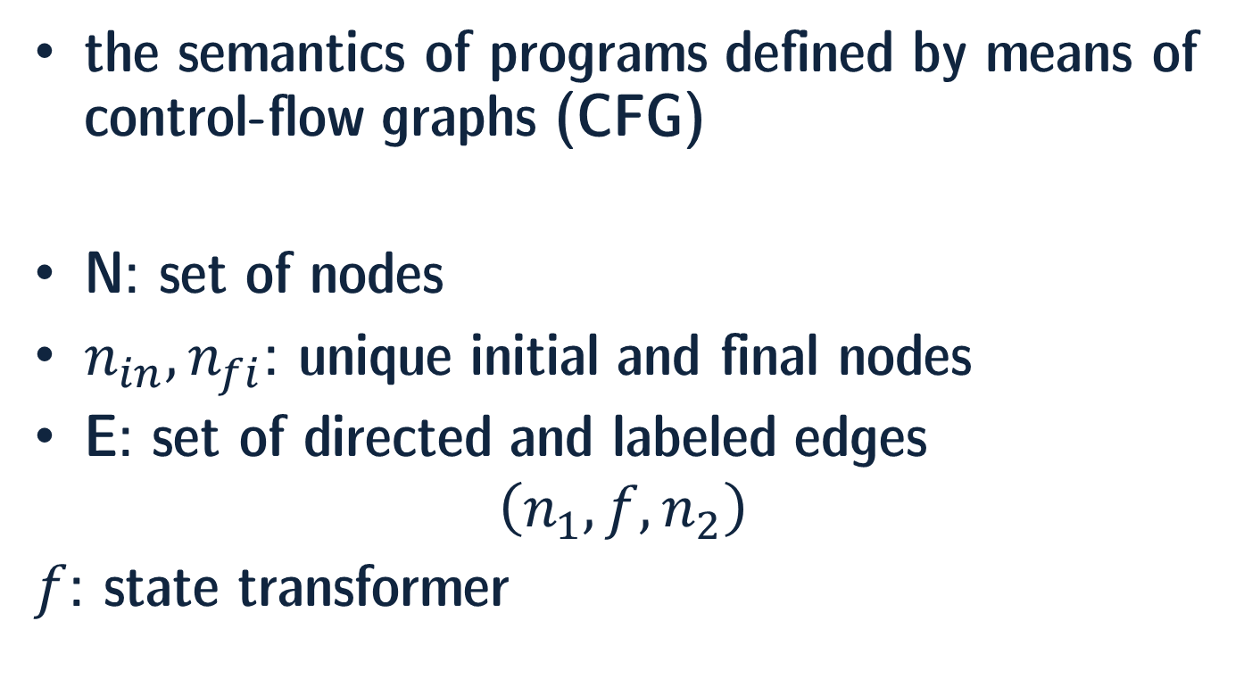
Merge Over All Twin Computations
the semantics of programs defined by means of control-flow graphs (CFG)
N: set of nodes
$n_{in}, n_{fi}$: unique initial and final nodes
E: set of directed and labeled edges
$$\left(n_{1}, f, n_{2}\right)$$
$f$: state transformer

Slide 39
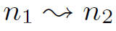
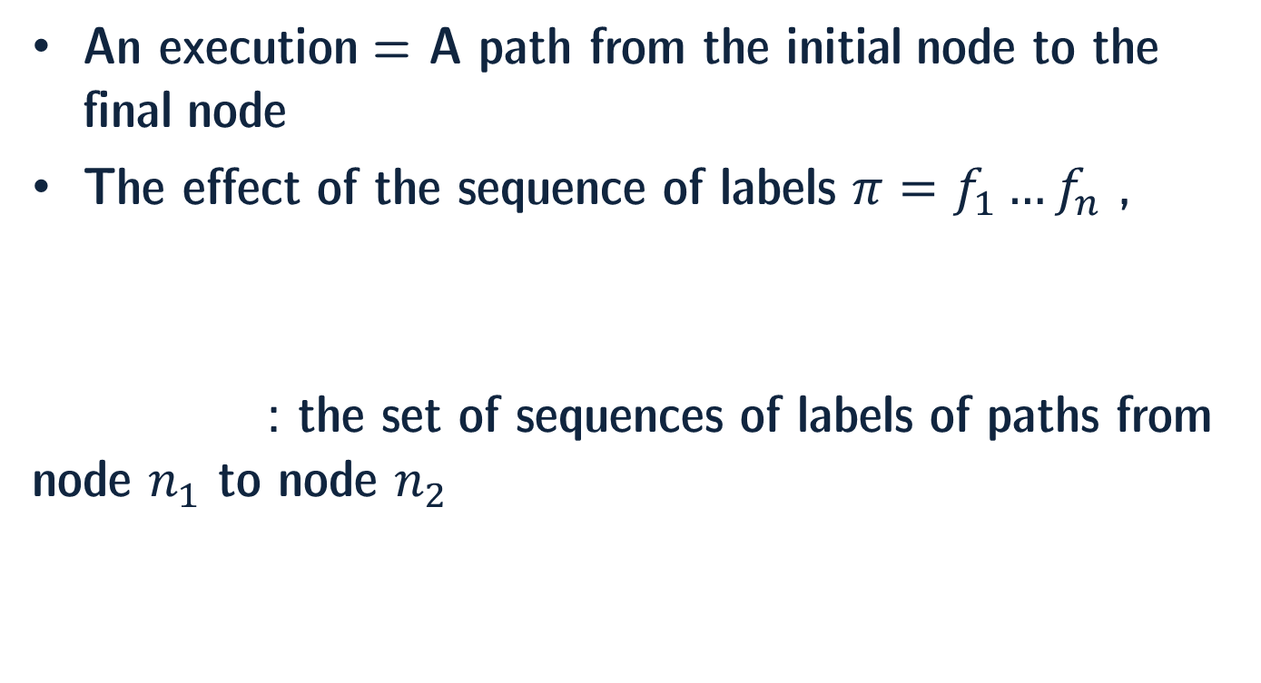
Merge Over All Twin Computations
An execution = A path from the initial node to the final node
The effect of the sequence of labels $π=f_{1}…f_{n}$ ,
: the set of sequences of labels of paths from node $n_{1}$ to node $n_{2}$

Slide 40

Merge Over All Twin Computations
We define a 2-hypersafety property by an initial and a final relation of program states $ρ_{in}, ρ_{fi}⊆S×S$
A program given by CFG $G=(N,E, n_{in}, n_{fi})$satisfies the 2-hypersafety property specified by in $ρ_{in} \text{a}\text{nd} ρ_{fi}$, if for all pairs of initial states $\left(s_{0}, t_{0}\right)∈ρ_{in}$ and all pairs of final states $s=⟦π_{1}⟧s_{0}$ and $t=⟦π_{2}⟧t_{0}$ reachable by arbitrary computations $π_{1},π_{2}∈n_{in} n_{fi}$, it holds that $\left(s,t\right)∈ρ_{fi}$.

Slide 41


Merge Over All Twin Computations
(𝔻, ⊑) complete lattice
$(𝒫\left(S×S\right), α, γ,\text{𝔻}\text{)}$ Galois connection
Powerset of pairs of states $𝒫\left(S×S\right)$
Abstraction function $α$:$𝒫\left(S×S\right)→$ $\text{𝔻}$
Concretization function $γ$: $\text{𝔻} →𝒫\left(S×S\right)$
Requirement for abstract transformers ${⟦f,g⟧}^{\#}$ of pairs of labels $(f,g)$ (called twin steps)

Slide 42


Merge Over All Twin Computations
The set of all possible alignments $A\left(π_{1},π_{2}\right)$is recursively defined by

Slide 43


Merge Over All Twin Computations
An alignment of two sequences of labels of a CFG, $π_{1}$ and $π_{2}$, is a sequence of twin steps $ω$ representing both of the original runs
If $s=⟦π_{1}⟧s_{0}$ , $t=⟦π_{2}⟧t_{0}$ , $ω∈A\left(π_{1},π_{2}\right)$ and $ω=\left(f_{1},g_{1}\right)…\left(f_{n},g_{n}\right)$ then $\left(s,t\right)=⟦ω⟧(s_{0},t_{0})$
For an abstract value $d_{0}$, the most precise abstract value $d$ that can be composed using the abstract semantics of twin steps:

Slide 44


Merge Over All Twin Computations
Given a CFG $G=(N,E, n_{in}, n_{fi})$ and the initial abstract value $d_{0}$, the merge over all twin computations solution is defined by:
The MTC solution can be considered as the extension of the MOP (meet over all paths) solution
Theorem -

Slide 45
Merge Over All Twin Computations
The MTC solution is an abstraction of all possible pairs of states resulting from any pair of executions of the program.
It might be difficult to compute the MTC solution directly.
A fixed alignment for each pair of paths obtained by constructing a self-composition GG of the CFG G.
Perhaps less precise but still sound solution

Slide 46

Merge Over All Twin Computations

Slide 47


Merge Over All Twin Computations
Given the CFG $G=(N,E, n_{in}, n_{fi})$ and a self-composition of it $GG=(N′,E′, {n′}_{in}, {n′}_{fi})$, the following holds for all $d_{0}$:
Any solution of the analysis problem corresponding to the self-composition GG of G is a safe overapproximation of MTC($G,d_{0}$).

Slide 48
Verification
Proving a 2-hypersafety property by means of this methods succeeds in two steps:
1- Constructing a self-composition GG of the CFG
2- Finding a decent abstract domain which achieve reasonable precision at an acceptable price

Slide 49



Self-Composition of CFG
pp2cfg (pair of programs to CFG) and pc2cfg (pair of commands to CFG)

Slide 50


Self-Composition of CFG
Computing a Best Alignment of Two Programs
Computing the Compositions of CFGs of Pairs of Commands
$$ω=\left(c_{1},d_{1}\right)…\left(c_{k},d_{k}\right)$$

Slide 51

Self-Composition of CFG
The roots of the ASTs corresponding to c and d are considered composable in the following cases:
In case the roots of the ASTs of the commands c and d are not composable, then we put them in sequence
Adding skip to each CFG labels

Slide 52



Self-Composition of CFG
For composable roots
Not branching constructs: pc2cfg$\left(c,d,n_{in},n_{fi}\right)=\left(n_{in},\left(c,d\right),n_{fi}\right)$
Branching constructs as follow

Slide 53

Proving Noninterference
XML documents are unranked ordered trees
Represented using binary trees by means of first-child-next-sibling

Slide 54


Proving Noninterference
$Σ_{2}$ : alphabet of binary nodes (models XML tags)
$Σ_{0}$ : alphabet of nullary nodes (models textual entities)
$𝒯_{Σ_{2}, Σ_{0}}$: set of binary trees

Slide 55

State transformers of edges (concrete transformers)

Slide 56

Proving Noninterference
Termination-Insensitive Noninterference
$if s_{0}{\left.​\right|}_{L}=t_{0}{\left.​\right|}_{L} then s{\left.​\right|}_{L}=t{\left.​\right|}_{L}$ $for all pairs of executions$
Abstract states: $d:Var→𝒫(𝒯_{Σ_{2},\left\{\#,bv,∗\right\}})$
$\left(s,t\right)∈γ\left(d\right) if for all variables x, \left(s\left(x\right),t\left(x\right)\right)∈γ(d\left(x\right))$
A pair of trees $𝒯_{1}, 𝒯_{2}$ is in the concretization of a set $Λ$ of abstract trees, if $Λ$ contains a tree $𝒯$ such that both $𝒯_{1}$ and $𝒯_{2}$ can be obtained from $𝒯$ by replacing the occurrences of bv with identical basic values, and the occurrences of * with any, possibly different subtrees.
Example - $Λ=\{a\left(∗,bv\right), b\left(bv,∗\right)\}$
$𝒯_{1},𝒯_{2}∈γ(Λ)$ for $𝒯_{1}$ = a(‘secret’,’2’) and $𝒯_{2}$ = a(‘SECRET’,’2’)

Slide 57

Proving Noninterference
Abstract values do not record sensitive data and precise information on basic values
$var_{x,n}$ : sets of public views for variable x occurring at a node n
Defined by means of Horn clauses
Disjunction of literals with at most one positive literal
$𝒯∈d\left(x\right) at node n if var_{x,n}\left(𝒯\right) holds$

Slide 58

Proving Noninterference
Assignments as Horn clauses
Transformers of the form $⟦x≔e_{1}\left(x_{1},..x_{n}\right), y≔e_{2}(y_{1},…,y_{n})⟧$
For all variables $z≠x and z≠y$ : $var_{z,n^{′}}\left(X\right)⟸var_{z,n}(X)$
For edges with label $(x≔y,x≔y)$ : $var_{x,n^{′}}\left(X\right)⟸var_{y,n}(X)$
For edges with label $(x≔σ_{2}(y,z),x≔σ_{2}(y,z))$ : $var_{x,n^{′}}\left(σ_{2}(L,R)\right)⟸var_{y,n}\left(L\right),var_{z,n}\left(R\right)$
For edges with label $(x≔y/1,x≔y/1)$ : $var_{x,n^{′}}\left(L\right)⟸var_{y,n}\left(σ_{2}\left(L,_\right)\right) for all σ_{2}$
For edges with label $(x≔y/2,x≔y/2)$ : $var_{x,n^{′}}\left(R\right)⟸var_{y,n}\left(σ_{2}\left(_,R\right)\right) for all σ_{2}$

Slide 59



Proving Noninterference
Assignments as Horn clauses
For edges with label $(f,f)$ where $f=x≔λ_{t}(x_{1}, …,x_{k})$
For edges with label $(x≔e\left(x_{1}…x_{k}\right), skip)$ and $\left(skip, x≔e\left(x_{1}…x_{k}\right)\right)$
Boolean Expressions as Horn clauses (similarly)

Slide 60

Proving Noninterference
Theorem - The abstract transformer ${⟦f,g⟧}^{\#}$ for a pair $(f,g)$ as defined by Horn clauses is a correct abstract transformer.
In other words, if $⟦f⟧\left(s_{0}\right)=s$ and $⟦g⟧\left(t_{0}\right)=t$where $\left(s_{0},t_{0}\right)∈γ\left(d_{0}\right)$ and ${⟦f,g⟧}^{\#}d_{0}=d$, then $\left(s,t\right)∈γ\left(d\right)$ holds.
The least solution of the set of Horn clauses defined for a program over-approximates the MTC solution.
Noninterference for a particular output variable x holds at program exit $n_{fi}$, if the predicate $var_{x,n}$ does not accept trees containing $∗$

Slide 61

Conclusion
An Introduction to Abstract Interpretation
Abstract Domain
Abstract Transform
Galois Connection
Relational Abstract Interpretation for Verification of 2-hypersafety properties
Via self-composition of CFG
XML manipulating language

Slide 62
References
[1] P. Cousot and R. Cousot. “Abstract interpretation: a unified lattice model for static analysis of programs by construction or approximation of fixpoints”. In 4th POPL, pages 238-252, Los Angeles, CA, 1977. ACM Press.
[2] P. Cousot. MIT Course 16.399: Abstract Interpretation. http://web.mit.edu/afs/athena.mit.edu/course/16/16.399/www/, 2005.
[3] C. Reichenbach, Goethe University Frankfurt Course, Foundations of Programming Languages, http://www.sepl.informatik.uni-frankfurt.de/2014-ws/m-ps/index.en.html, 2014.
[4] M. Kovács, H. Seidl, and B. Finkbeiner. "Relational abstract interpretation for the verification of 2-hypersafety properties." Proceedings of the 2013 ACM SIGSAC conference on Computer & communications security. ACM, 2013.
[5] A. Chudnov, G. Kuan, and D. A. Naumann. "Information flow monitoring as abstract interpretation for relational logic." Computer Security Foundations Symposium (CSF), 2014 IEEE 27th. IEEE, 2014.

Slide 63

Any Questions?

Slide 64
Introduction
Formal Verification: proving the semantics of a program satisfies its specification
Abstract interpretation formalizes the idea that this formal proof can be done at some level of abstraction where irrelevant details about the semantics and the specification are ignored
proving that an abstract semantics satisfies an abstract specification

Slide 65
Introduction
Abstractions should preferably be sound (no conclusion derived from the abstract semantics is wrong relative to the program concrete semantics and specification)
a proof that the abstract semantics satisfies the abstract specification should imply that the concrete semantics also satisfies the concrete specification.
Hoare logic is a sound verification method, debugging is not (since some executions are left out), bounded model checking is not either (since parts of some executions are left out). Unsound abstractions lead to false negatives (the program may be claimed to be correct/non erroneous with respect to the specification whereas it is indeed incorrect)

Slide 66
Introduction
Abstractions should also preferably be complete (no aspect of the semantics relevant to the specification is left out)
if the concrete semantics satisfies the concrete specification this should be provable in the abstract.
However program proofs are undecidable, and so automatic tools for reasoning about programs are all incomplete (for non trivial program properties such as safety, liveness, or security) and must therefore fail on some programs.

Slide 67
Introduction
This can be achieved by allowing the tool not to terminate, to be unsound (e.g. debugging tools omit possible executions), or to be incomplete (e.g. static analysis tools may produce false alarms). Incomplete abstractions lead to false positives or false alarms (the specification is claimed to be potentially violated by some program executions while it is not).
Potentially non-terminating and unsound program verification tools are easy to design. Terminating and sound tools are much more difficult to design. Complete tools are impossible to design, by undecidability.

Slide 68
Introduction
However static analysis tools producing very few or no false alarms have been designed and used in industrial contexts for specific families of properties and programs
In all cases, abstract interpretation provides a systematic construction method based on the effective approximation of the concrete semantics, which can be (partly) automated and/or formally verified.

Slide 69
Introduction
Abstract interpretation aims at providing a basic coherent and conceptual theory for understanding in a unified framework the thousands of ideas, concepts, reasonings, methods, and tools on formal program analysis and verification
guiding the correct formal design of automatic tools for program analysis(computing an abstract semantics) and program verification (proving that an abstract semantics satisfies an abstract specification)
Abstract interpretation theory studies semantics (formal models of computer systems), abstractions, their soundness, and completeness.

Slide 70
Introduction
Static analysis is the automatic determination of abstract program properties including Dataflow Analysis Set-based Analysis, etc. This was the motivating application behind the introduction of the abstract interpretation theory.
Its Application in: Syntax, Semantics, Proofs, Static Analysis, Types, Model Checking, Program Transformation, Malware Detection, Termination Analysis.

Slide 71
Introduction
An abstract domain is an abstract algebra, often implemented as a library module, providing a description of abstract program properties and abstract property transformers describing the operational effect of program instructions and commands in the abstract. Abstract domains are often complete lattices, an abstraction of powersets

Slide 72
Introduction
MOP (Merge Over all Paths): The first dataflow analyses where proved correct by comparing the union of the abstraction along all execution paths (so-called MOP solution) with a fixpoint solution using transfer functions (i.e. abstract property transformer)
Instead of comparing one solution of the static analysis problem to another one, the theory of abstract interpretation introduced the idea that the correctness/soundness should be expressed with respect to a formal semantics. A consequence is that static analysis algorithms can be specified and designed by approximation of a program semantics. Moreover, the "fixpoint solution" was shown to be an abstraction of the "MOP solution".

Slide 73
Introduction
The collecting semantics or non-standard semantics is the semantics of the language formally defining the program execution properties of interest to be analyzed by abstraction. These program executions themselves are formalized by the standard semantics.
For example, the standard semantics is an operational semantics. The concrete properties of interest are invariance properties so the collecting semantics defines the reachable states from initial states. This collecting semantics is expressed as the least fixpoint of equations using strongest postcondition transformers. Thus the considered abstractions provide abstract invariance properties (overapproximating the reachable states).

Slide 74
Introduction
Galois connections can be used when the abstract domain always offers a most precise approximation of any concrete property
An interesting consequence of the existence of the best abstraction of concrete properties is the existence of best/most precise transformers, which provides guidelines for their [automatic] design. Moreover by abstracting fixpoints by fixpoints, static analysis is specified by an abstract semantics expressed in fixpoint form whereas a static analyzer is an algorithm for computing or overapproximating this fixpoint.

Slide 75
Introduction
Most program properties can be expressed as fixpoints of monotone or extensive property transformers, a property preserved by abstraction. This reduces program analysis to fixpoint approximation and verification to fixpoint checking.
A consequence of the formalization of static analyses by Galois connections is that they can be organized into a complete lattice according to the partial order of their relative precisions
Notes:
Kind: type class, family of types

